Slide 1


Kendriya Vidyalaya
ONGC
Computer Science
2013-14
Project
By – Divya Mamgai

Slide 2

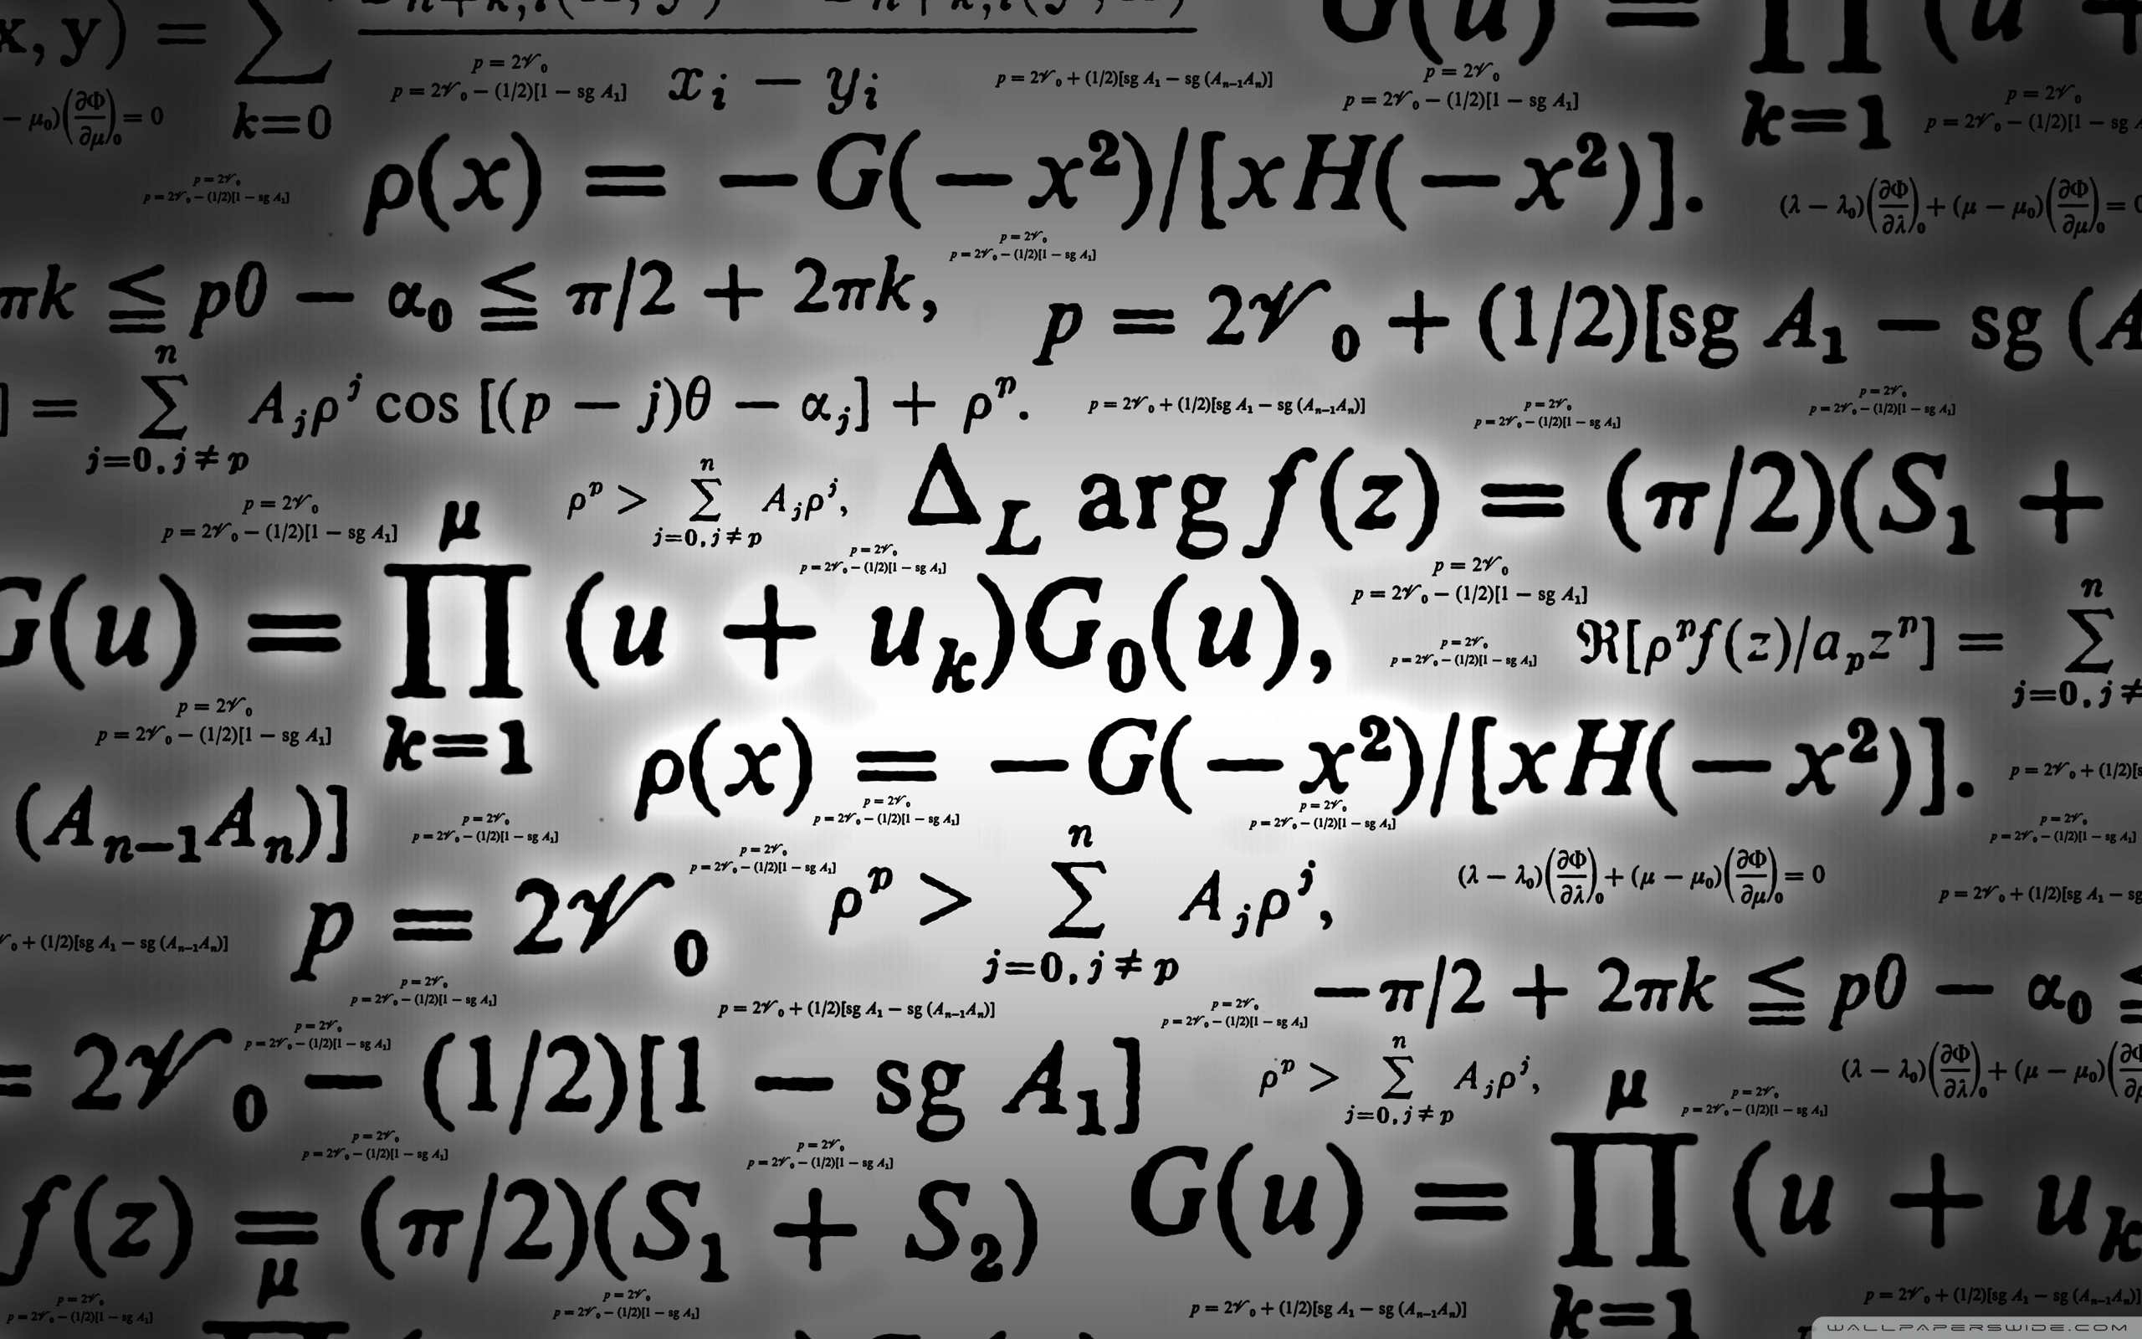

CALCULATOR
1.0
Redefining the Calculator
Bringing GUI to C++
User-Friendly
Effective
By
Divya Mamgai (XIIth)
To
Namrata Shah

Slide 3
CALCULATOR
1.0
 | Introduction
 | Objective
 | Synopsis
 | Program Description System Study Existing System Proposed System Future Scope Feasibility Study
 | System Design And Development System Environment Language Description Platform Development
 | System Testing

Slide 4
CALCULATOR
1.0
 | System Security
 | System Implementation Function List Source Code Output
 | Conclusion And Bibliography

Slide 5
Introduction
Calculator.1.0 is a program that understands the importance of time in your life. It enables you to perform simple calculations to some mind boggling ones, with ease!
The program utilizes the concept of hand-input (Key-Input) rather than old-fashioned choice input that are found in almost all of the console-based programs out there. And with the swift shortcut keys, one can easily multitask while performing various calculations. Also you can listen to favorite tune while doing math. The user-friendly UI (FUI) lets do more with less! Carefully designed settings for the program lets you tune it to your liking.
Calculator.1.0 is mainly targeted for people with daily need for math calculations, but also comes in handy for some who like keep track of current currency-rates. Some would like to convert units, some might want to use the classic Calc with more cool features, or some might just want to sit back and read the information this program can give about various mathematical related terms!

Slide 6
Objective
Calculator.1.0 is a vision for making people see the power of C++ and how many different tasks this simple language can perform. It destroys the barrier of a console program lagging behind in terms of input facility by using complex algorithm to make sure you get close experience to what a GUI program might give you.
Calculator.1.0 is mainly build with the objective – All In One. A calculator that only does not give you basic functionality that a calculator should but provides far more features.

Slide 7
Program Description
System Study
Calculators are complex machines and makes the lives of people very easy going. The Calculators have been friend of scientists for a long time and even for the students studying in school, colleges or even the teachers and professors teaching them.
Calculator ever since invented has proved it’s credibility for the success of Human Race.
Existing System
Current Calculators lacks the innovation and as a result they are too complex to be used by certain users. As a result their users are very less. Their use is certainly minimalized because of this factor as not everyone can understand the meaning of the complex functions these Calculators use.
Proposed System
The new system that is implemented by this program is the system of ease. Now everyone even if he/she don’t know much about the complex functions these Calculators use, they can just followed the wizard provided by this program to the user.
The program utilizes a new concept of input and output, and makes use of a whole new level programming which promises to be robust.

Slide 8
Program Description
Future Scope
The Calculator is aimed to be used world-wide, by students, teachers, and even scientists. It’s ability to give up to-date currency rates makes it quit handy for economy minded persons. Also with use of GUI – Like interface it is sure to make it’s impact on the minds of the future generation.
Feasibility Study
More 2D and 3D shapes can be easily incorporated in this program along with the latest equations and information because it’s user-friendly interface. Also with it’s easy to understand codes it can be easily developed further by any programmer to their hearts content. The program comes with the inbuilt software to allow users to easily add new data about scientific stuff, and also new conversion rates.

Slide 9
System Design And Development
System Environment
Calculator is designed with keeping maximum compatibility in mind and thus works with wide-range of OS. The general list of OS it supports is [Note: There might be more such OS, other than the ones listed here.]
Windows XP SP1/SP2/SP3 [32-bit/64-bit] - 100%
Windows Vista SP1/SP2 [32-bit/64-bit] - 100%
Windows 7 SP1/SP2 [32-bit/64-bit] - 100%
Windows 8 / 8.1 [32-bit/64-bit] - 80%
Warning: On Windows 8/8.1 Dev-Cpp is not fully supported, so the user might not be able to use Calc functionality in Windows 8/8.1.

Slide 10
System Design And Development
Language Description
C++ (pronounced see plus plus) is a programming language that is general purpose, statically typed, free-form, multi-paradigm and compiled. It is regarded as an intermediate-level language, as it comprises both high-level and low-level language features. Developed by Bjarne Stroustrup starting in 1979 at Bell Labs, C++ was originally named C with Classes, adding object oriented features, such as classes, and other enhancements to the C programming language. The language was renamed C++ in 1983, as a pun involving the increment operator.
C++ is one of the most popular programming languages and is implemented on a wide variety of hardware and operating system platforms. As an efficient compiler to native code, its application domains include systems software, application software, device drivers, embedded software, high-performance server and client applications, and entertainment software such as video games. Several groups provide both free and proprietary C++ compiler software, including the GNU Project, LLVM, Microsoft and Intel. C++ has greatly influenced many other popular programming languages, most notably C# and Java.
The language began as enhancements to C, first adding classes, then virtual functions, operator overloading, multiple inheritance, templates and exception handling, among other features. After years of development, the C++ programming language standard was ratified in 1998 as ISO/IEC 14882:1998. The standard was amended by the 2003 technical corrigendum, ISO/IEC 14882:2003. The current standard extending C++ with new features was ratified and published by ISO in September 2011 as ISO/IEC 14882:2011 (informally known as C++11).

Slide 11
System Design And Development
Platform Development
Bloodshed Dev-C++ is a full-featured Integrated Development Environment (IDE) for the C/C++ programming language. It uses Mingw port of GCC (GNU Compiler Collection) as it's compiler. Dev-C++ can also be used in combination with Cygwin or any other GCC based compiler. Features are : - Support GCC-based compilers - Integrated debugging (using GDB) - Project Manager - Customizable syntax highlighting editor - Class Browser - Code Completion - Function listing - Profiling support - Quickly create Windows, console, static libraries and DLLs - Support of templates for creating your own project types - Makefile creation - Edit and compile Resource files - Tool Manager - Print support - Find and replace facilities - CVS support

Slide 12
System Testing
Button Input
On pressing a certain key the desired output is always obtained.
Data Input
Only the required keys are responding for data input, which makes makes the program robust and bug free.
About Data Generation
The About Data is been correctly generated using the aboutdata.bin file.
Unit Conversion Data Generation
The Unit Conversion data is being correctly decoded and reformatted by the program to produce the desired result from the conversiondata.bin.
Menu
All the menu are rendering correctly and are bug-free.
Currency Rate Updating
The program is successfully able to connect to the internet and receive the required data as per requirement.
Currency Rate Rendering
The program is able to correctly and precisely render the data the from the currenyratedate.bin

Slide 13
System Testing
Calc Functions
The program is able to correctly capture the mathematical expression entered by the user and is able to produce the precise result.
Scroll Input
The input frame is responding well on the commands of the arrow keys of the keyboard.
Error Handling
The error handling is working as expected and is reporting user from time to time about the current error.
Settings Update
The settings are being updated as per requirements, and are being handled by the program the way they meant to be.

Slide 14
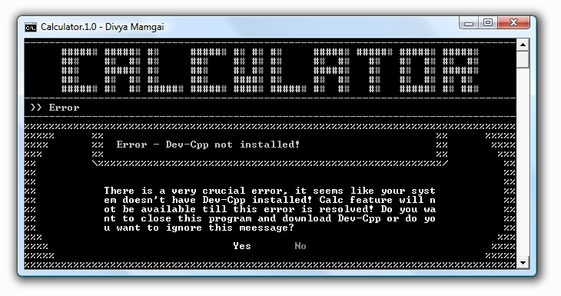
System Security
Calculator provides maximum system security by utilizing real-time error handling.
Calculator doesn’t let the user enter false values, which makes it the best error handling system. The Calculator is designed in such a way that it stays close to the user, and as soon as some error is generated, the program notifies the user.
For Eg.: If your system doesn’t have Dev-Cpp Installed the program will automatically generate an error and reminding you of its consequences. The same can be seen in the screen-shot below:
Although one can by-pass this error, but the program automatically shuts down the areas where it repercussions might appear. In the above mentioned case the Calc functionality is shut-down as a result of this error.

Slide 15
System Implementation
Function List
1 | void InitializeVariable();
2 | int VariableIsEmpty(int,int,int);
3 | void EmptyVariable(int,int,int);
4 | void InitializeTheme();
5 | void CursorToggle(int);
6 | void SetConsoleDimensions(int,int);
7 | void SetCord(short,short);
8 | WORD GetConsoleTextAttribute(HANDLE);
9 | void WebLinkLaunch(char*);
10 | string WebGetData(char*);
11 | int GetCurrentDate(int);
12 | void CopyFileNew(char*,char*);
13 | void ClearFileContents(char*);
14 | void ColorOut(char,int);
15 | void ColorOut(char*,int);
16 | void ColorOut(string,int);
17 | void PauseConsole(float);
18 | void Music(int,int);
19 | void KeypressSound();
20 | void BackgroundMusic(void*);

Slide 16
System Implementation
Function List
21 | void IntroMisc(void*);
22 | void SettingsUpdateOnTerminate(void*);
23 | void Terminate(int);
24 | int StringLength(char*);
25 | int StringLength(string);
26 | void StringInterpret(string&,int,string StringReplaceDefault = "");
27 | void Header();
28 | void HeaderMisc(int,int);
29 | void ClearConsole(int);
30 | void ClearFrame(short,short,int,int);
31 | void ButtonFunctions(int);
32 | int CreateButtons(int,button[],int[][2],int[][2],int);
33 | int CreateDialogBox(char[],char[],int,int,int,int[5],int ForceShiftX = 0,int ForceShiftY = 0);
34 | void FirstTimeIntro(int);
35 | void CurrentAddress(char[]);
36 | void MainFrame();
37 | void DefaultMainFrame();
38 | void FrameHeader(short,short,int,short,char*,int);
39 | void StringOut(int,short,short,int,int,string InterpretString = "");

Slide 17
System Implementation
Function List
40 | void StringOut(string,short,short,int,int,string InterpretString = "");
41 | void StringOut(string&,short&,short&,int&,int,string InterpretString = "");
42 | int StringDigitValidation(string);
43 | int StringUnitsValidation(string);
44 | int ScrollInput(short,short,short,scrolllist[],int,int,int AdditionalStringID = 83);
45 | void InputDataVariable(int,input);
46 | string SettingsValueInterpreter(int,int);
47 | void SettingsChanger(int,int,int,int);
48 | void UpdateSettingsMenu();
49 | void CurrencyOneToManyCalculate();
50 | void Calc();
51 | void Menu(int);
52 | void About(char*,int,int,char*);
53 | double GetCurrencyRate(char*,char*);
54 | void UpdateCurrencyRatesTerminator(void*);
55 | void UpdateCurrencyRates();
56 | void UnitConversionScrollListGenerator(scrolllist*,int,char*);
57 | double UnitConversionFromFile(char*,int,int,double);
58 | string UnitConvertor(int,int,int);

Slide 18
System Implementation
Function List
59 | double Calculate(int);
60 | int CheckDev();
61 | void ExitProgram(void);

Slide 19
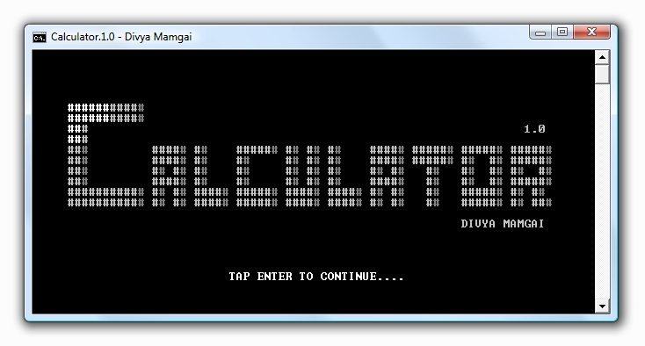
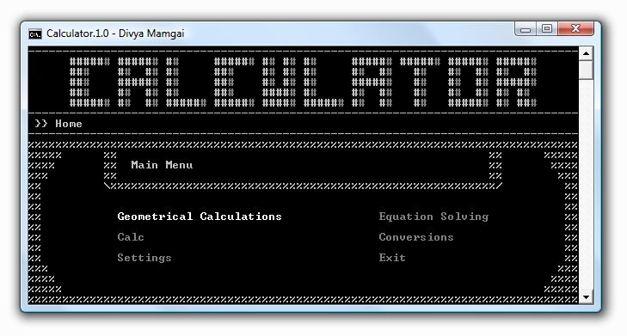
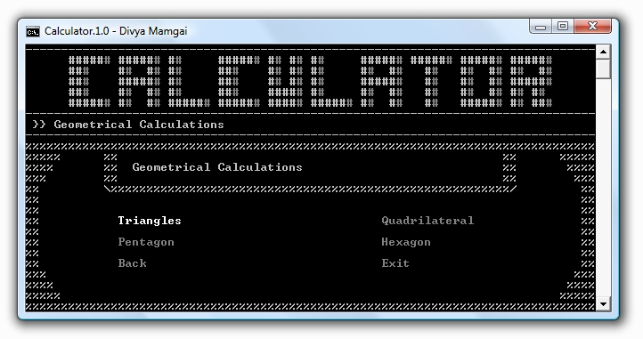
System Implementation
Output

Slide 20
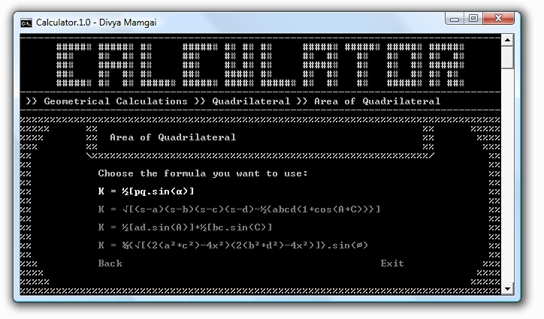
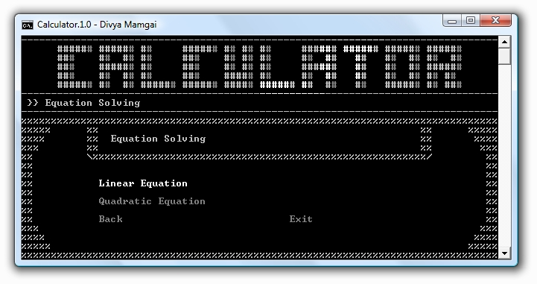
System Implementation
Output

Slide 21
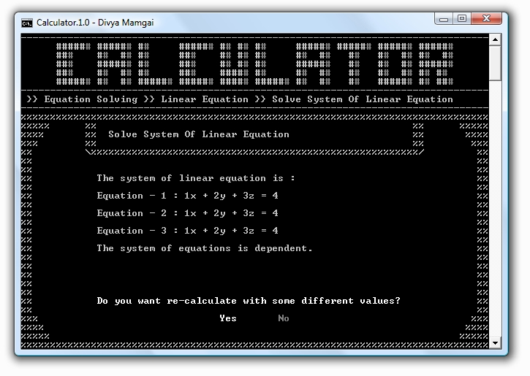
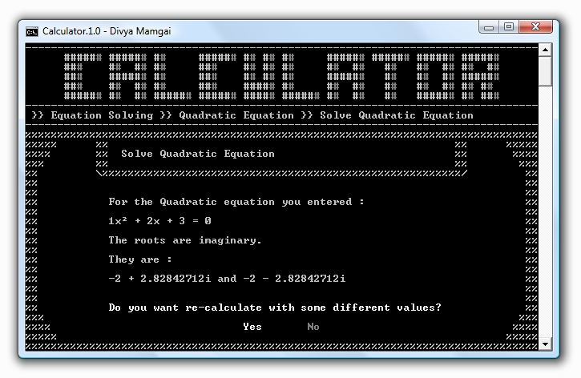
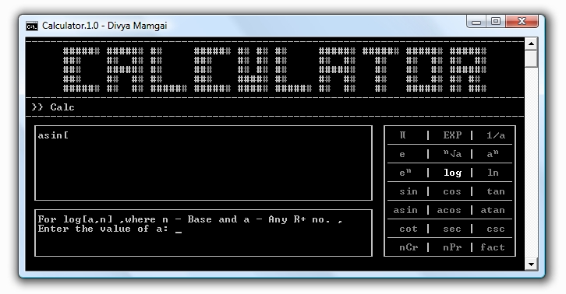
System Implementation
Output

Slide 22
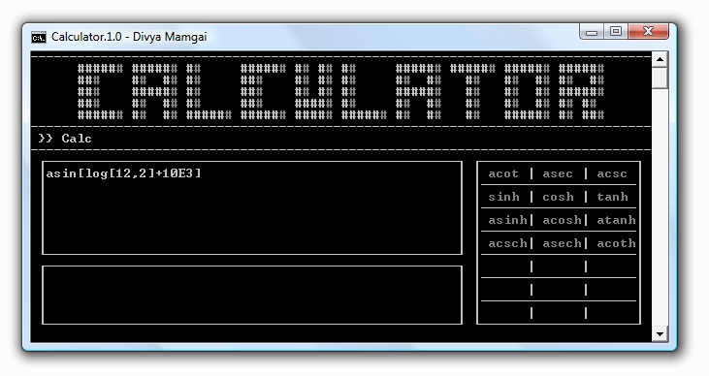
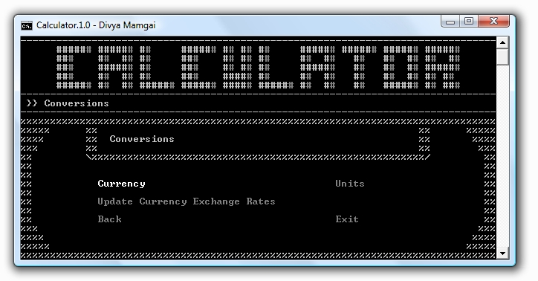
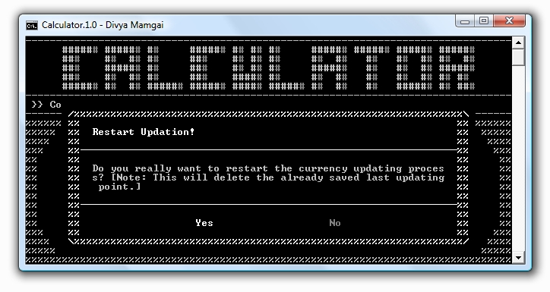
System Implementation
Output

Slide 23
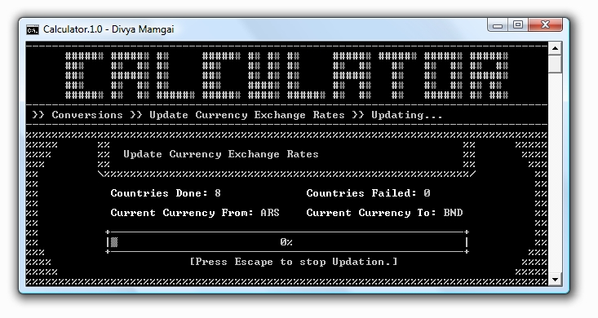
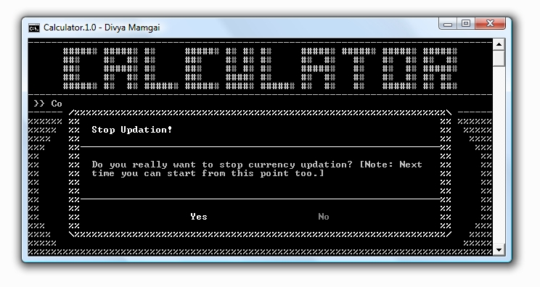
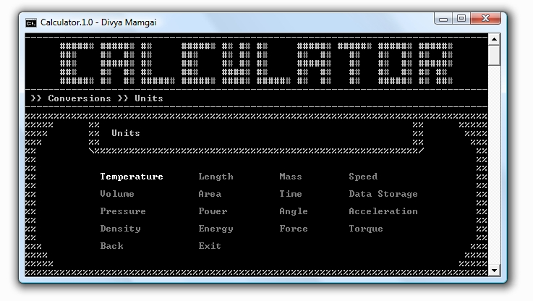
System Implementation
Output

Slide 24
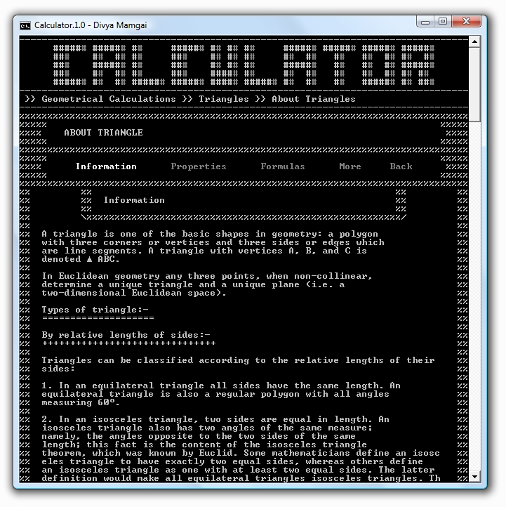
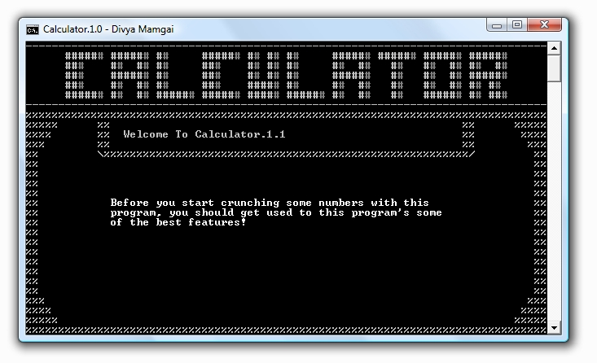
System Implementation
Output

Slide 25
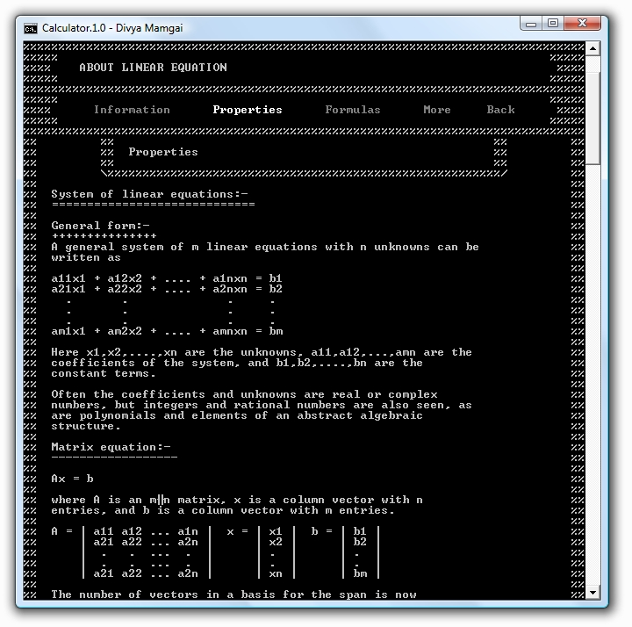
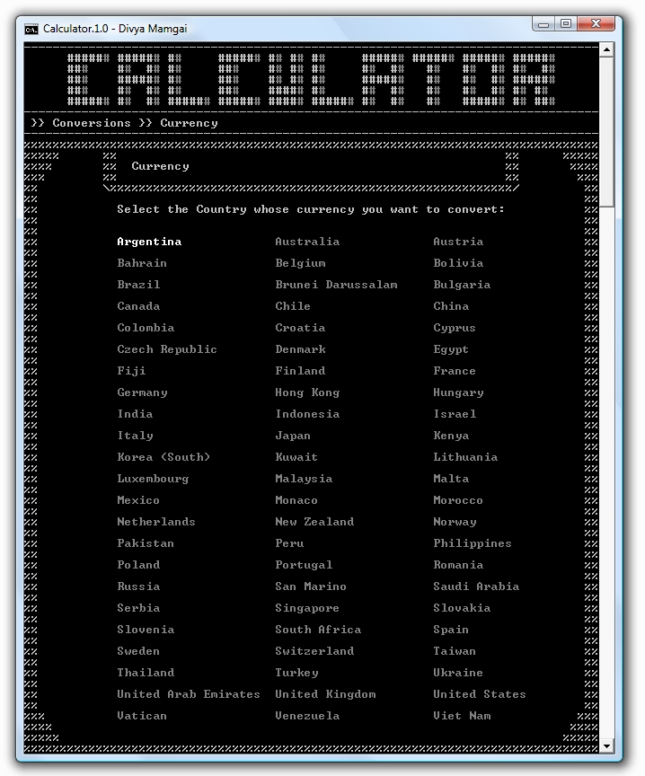
System Implementation
Output

Slide 26
Conclusion And Bibliography
All in all Calculator promises to change the way C++ Console – Based programs are seen, with it’s GUI – Like features and a Development – Friendly environment this program promises to perform best at every given condition.
The About and Unit Conversion data were taken from:
http://en.wikipedia.org/wiki/Main_Page
http://www.smartconversion.com/
The web-links for various elements in the program the following website is used:
http://mathworld.wolfram.com/

